Slide 1
Docker for Windows -10
Troubleshooting

Slide 2
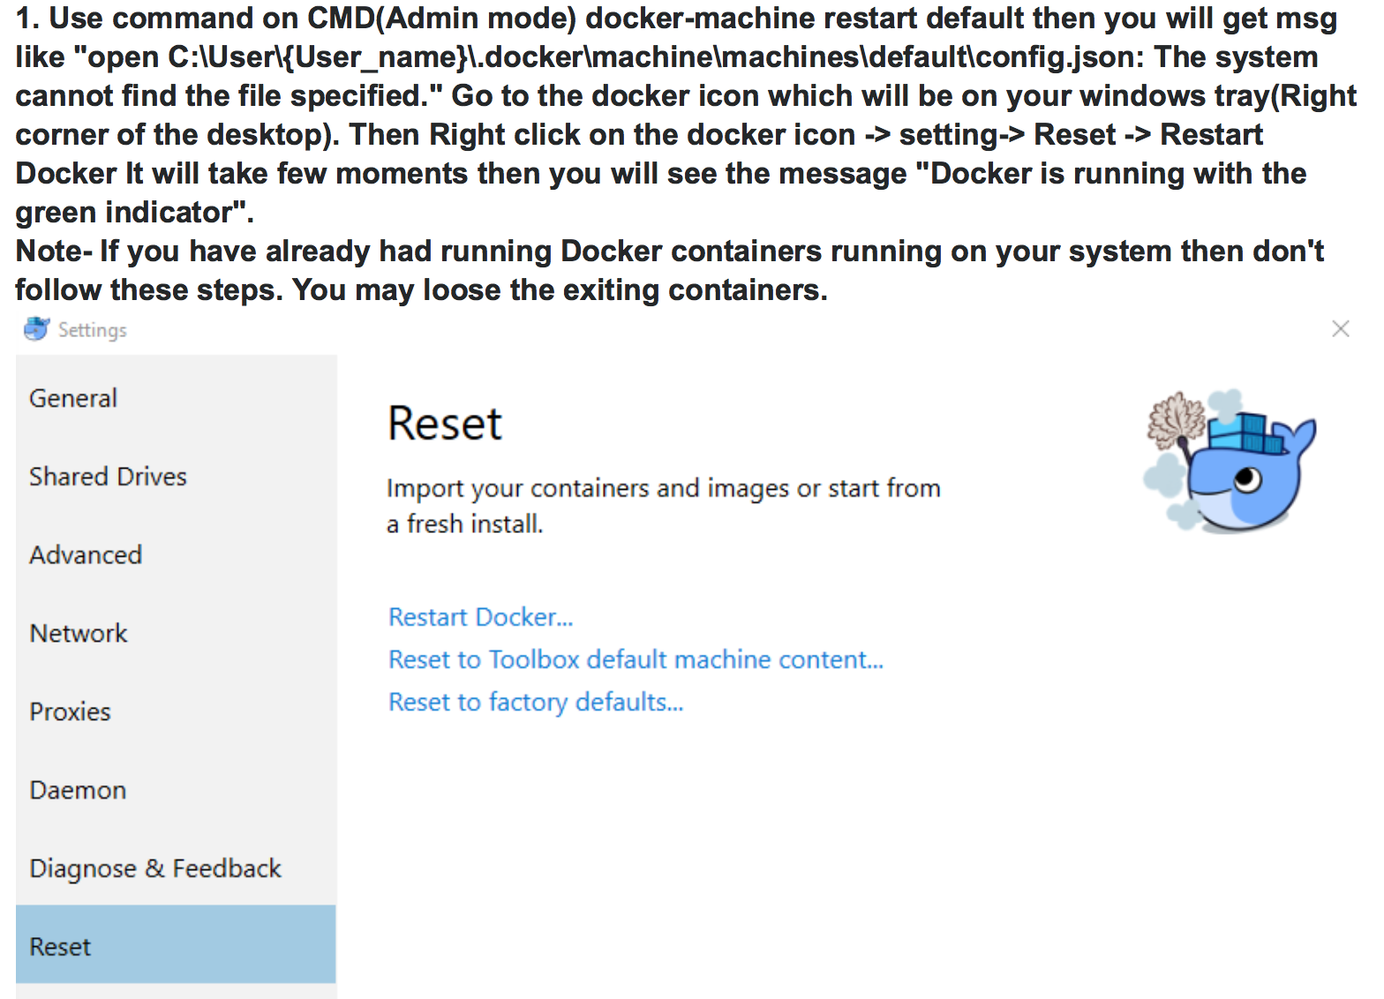
Docker cannot start on Windows

Slide 3
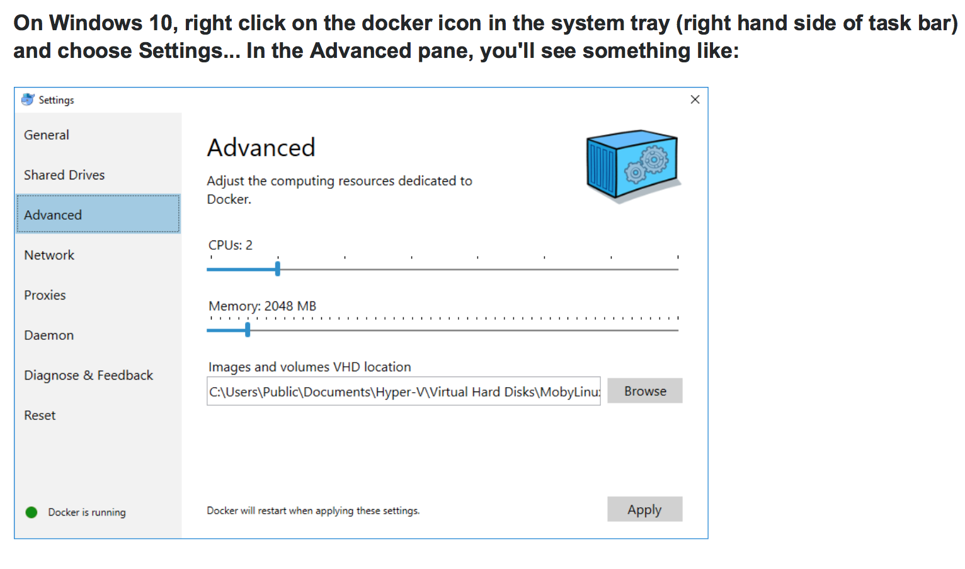
Docker image location on Windows 10

Slide 4
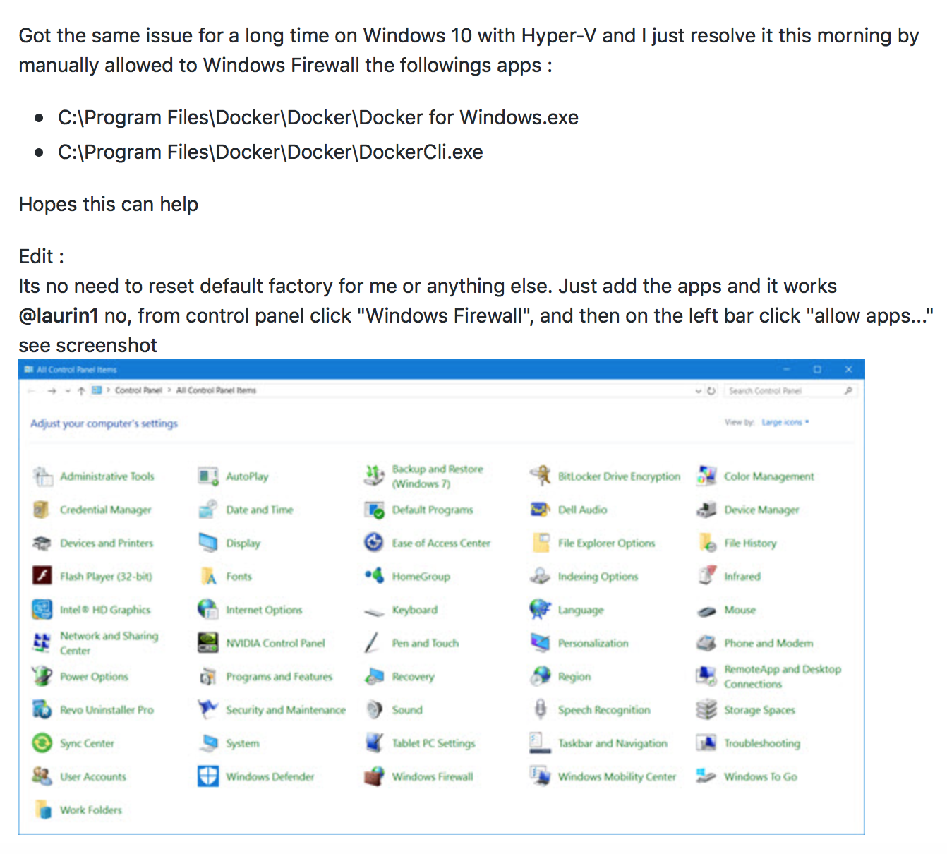
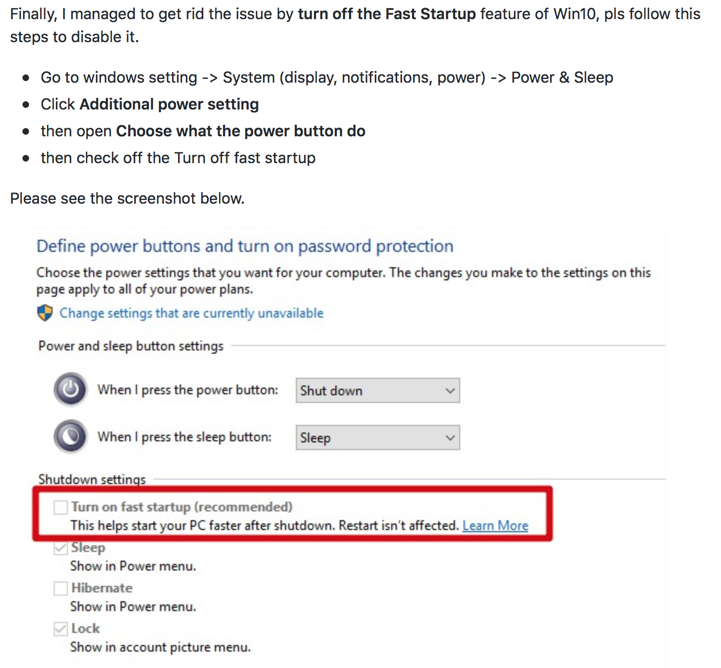
Docker command did not complete within the allowed timeout

Slide 5
References
Get started with Docker for Windows
How to install Docker on Windows 10
Docker Machine Windows 10 Hyper-V Troubleshooting Tips
Docker for Windows - Troubleshoot

